Slide 1


McKesson Corp
NYSE - (MCK)
Prepared by
Xander Minch
aledminc@iu.edu
James Drew
jwdrew@iu.edu
Aayush Iyer
iyeraayu@iu.edu
Alex Sheth
alsheth@iu.edu
03/1/2025

Slide 2
Company Overview
McKesson Corp
Core Business Segments:
US Pharmaceutical (Main Revenue)
Distributes branded, generic, specialty, biosimilar and over-the-counter pharmaceutical drugs
Works with major pharmacy chains like CVS, Walgreens, and independent pharmacies.
Prescription Tech Solutions (RxTS)
Connects patients, pharmacies, and providers to get medicine to people in need
Provides price transparency, benefit insight, and wholesale distribution support services
Medical-Surgical Solutions
Provides medical-surgical supply to clinical offices, healthcare providers, nursing homes, etc.
International (services to retail customers EU and Can)
Advantage:
#1 Pharma Distributor in NA
30% Market Share
Reach Outside US
Owns market share in Canada and Europe
Investing Heavily in AI
Improve supply chain automation and efficiency
Notes:
Sell your investment to the club!
Convince peers to invest
Salesman role (tell a story!)
-Background
-Strengths / weaknesses
-Financial analytics
-Unique success factors AND risks
-Executive leadership group
-Enter / exit strategy

Slide 3
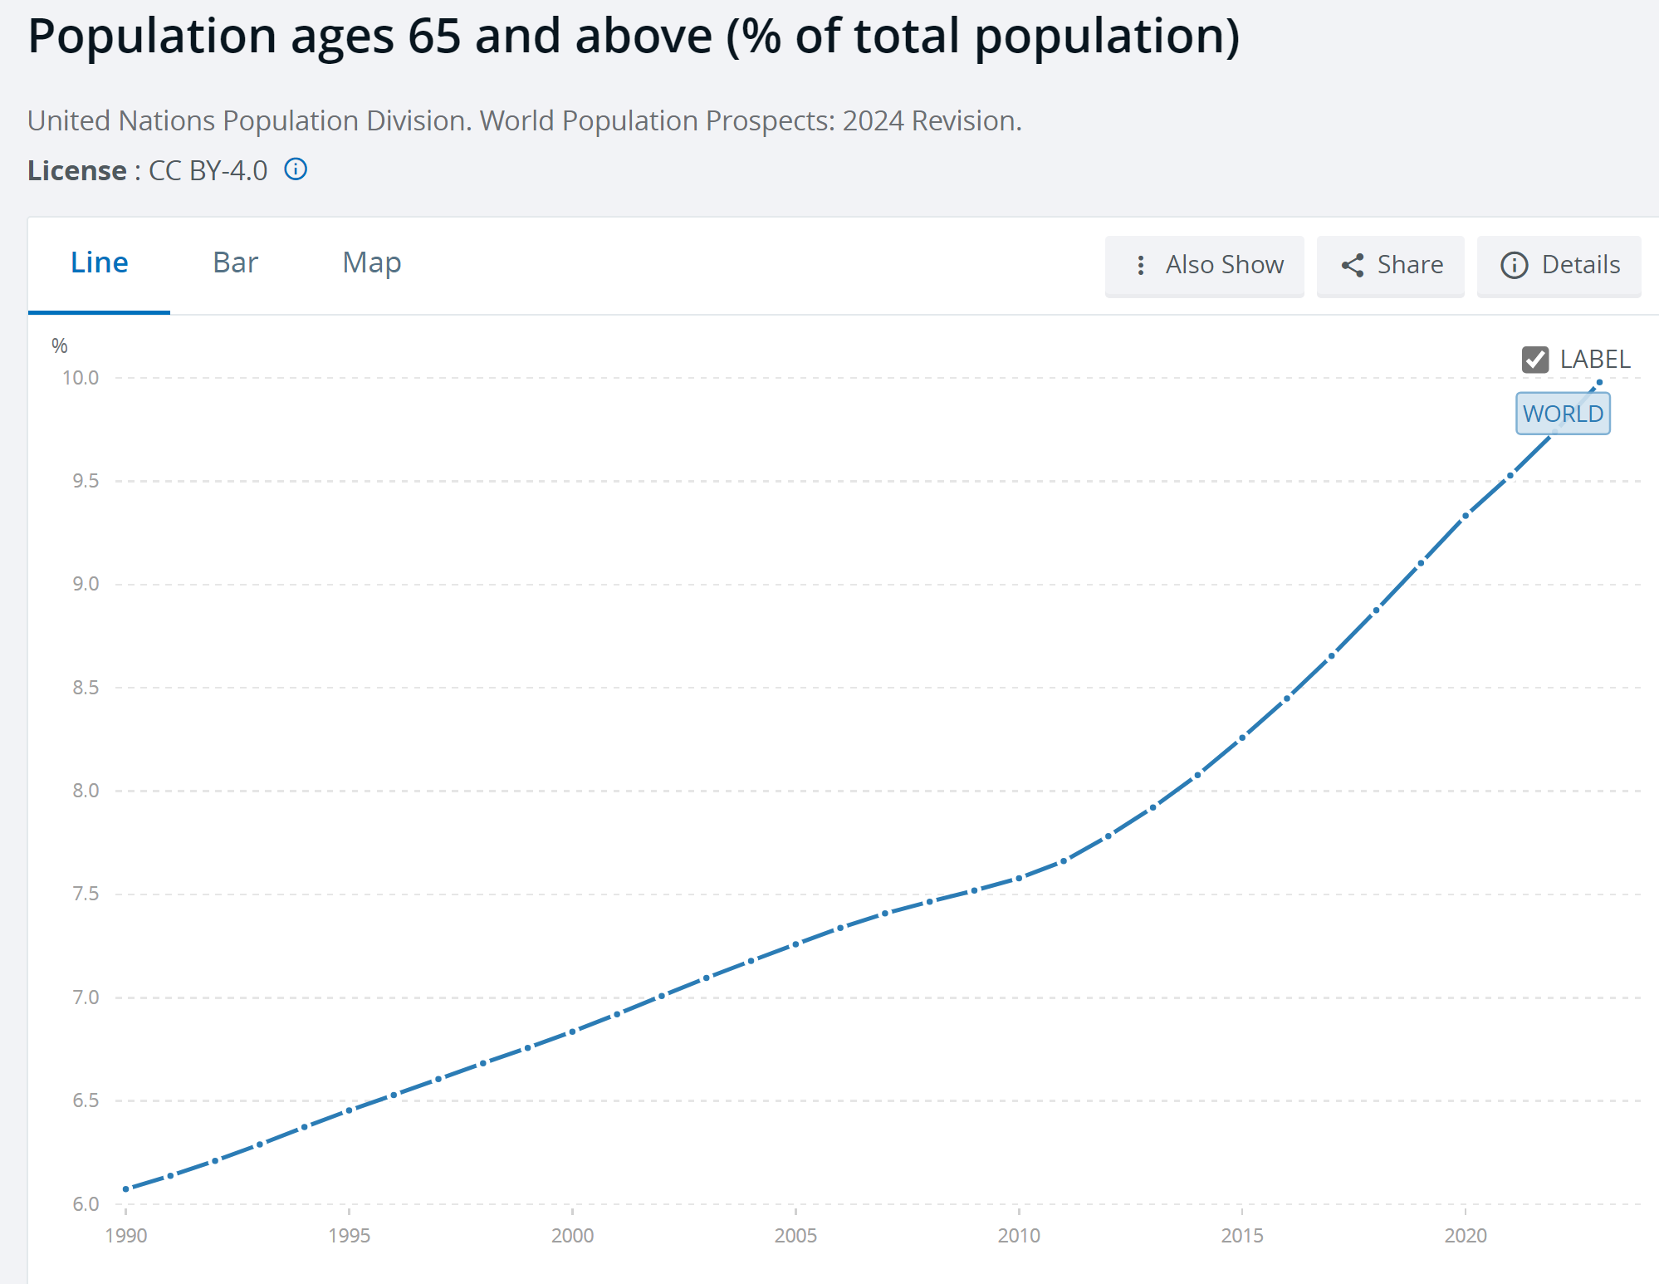
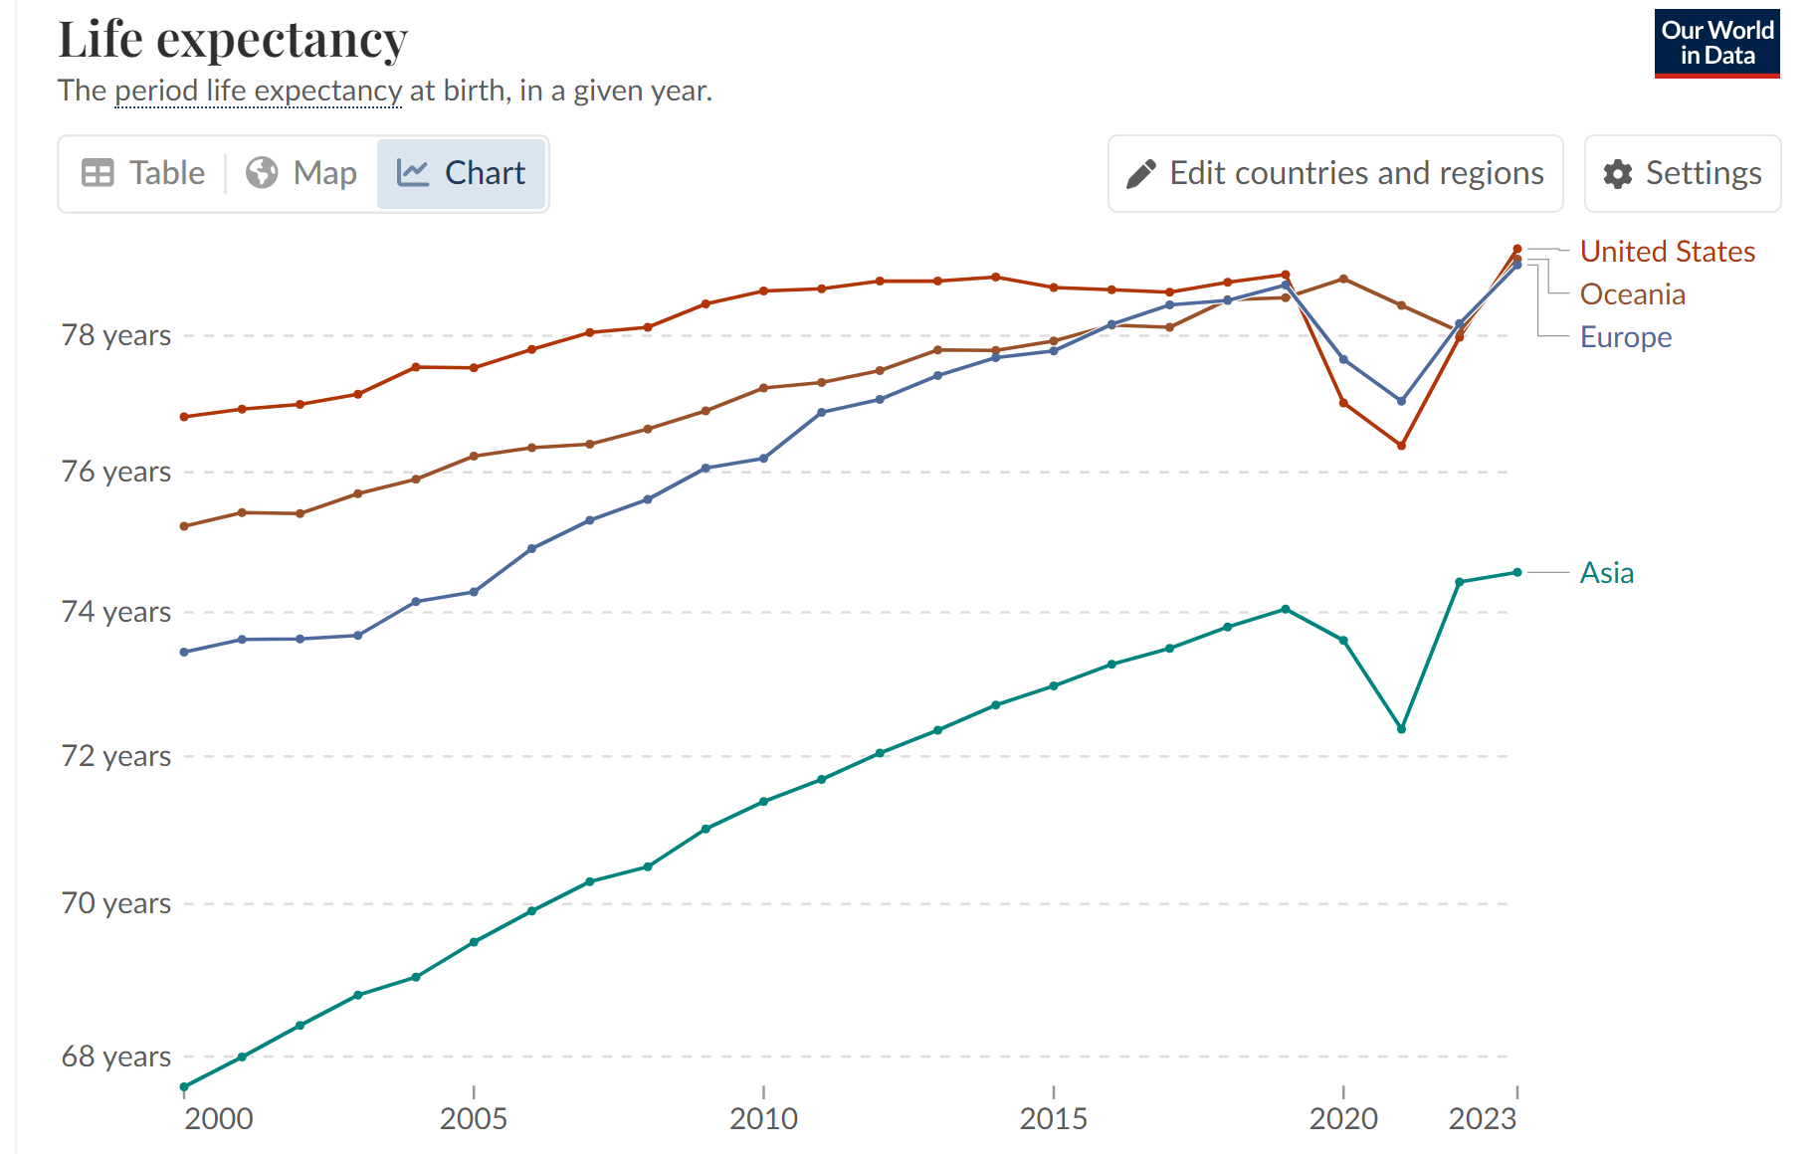
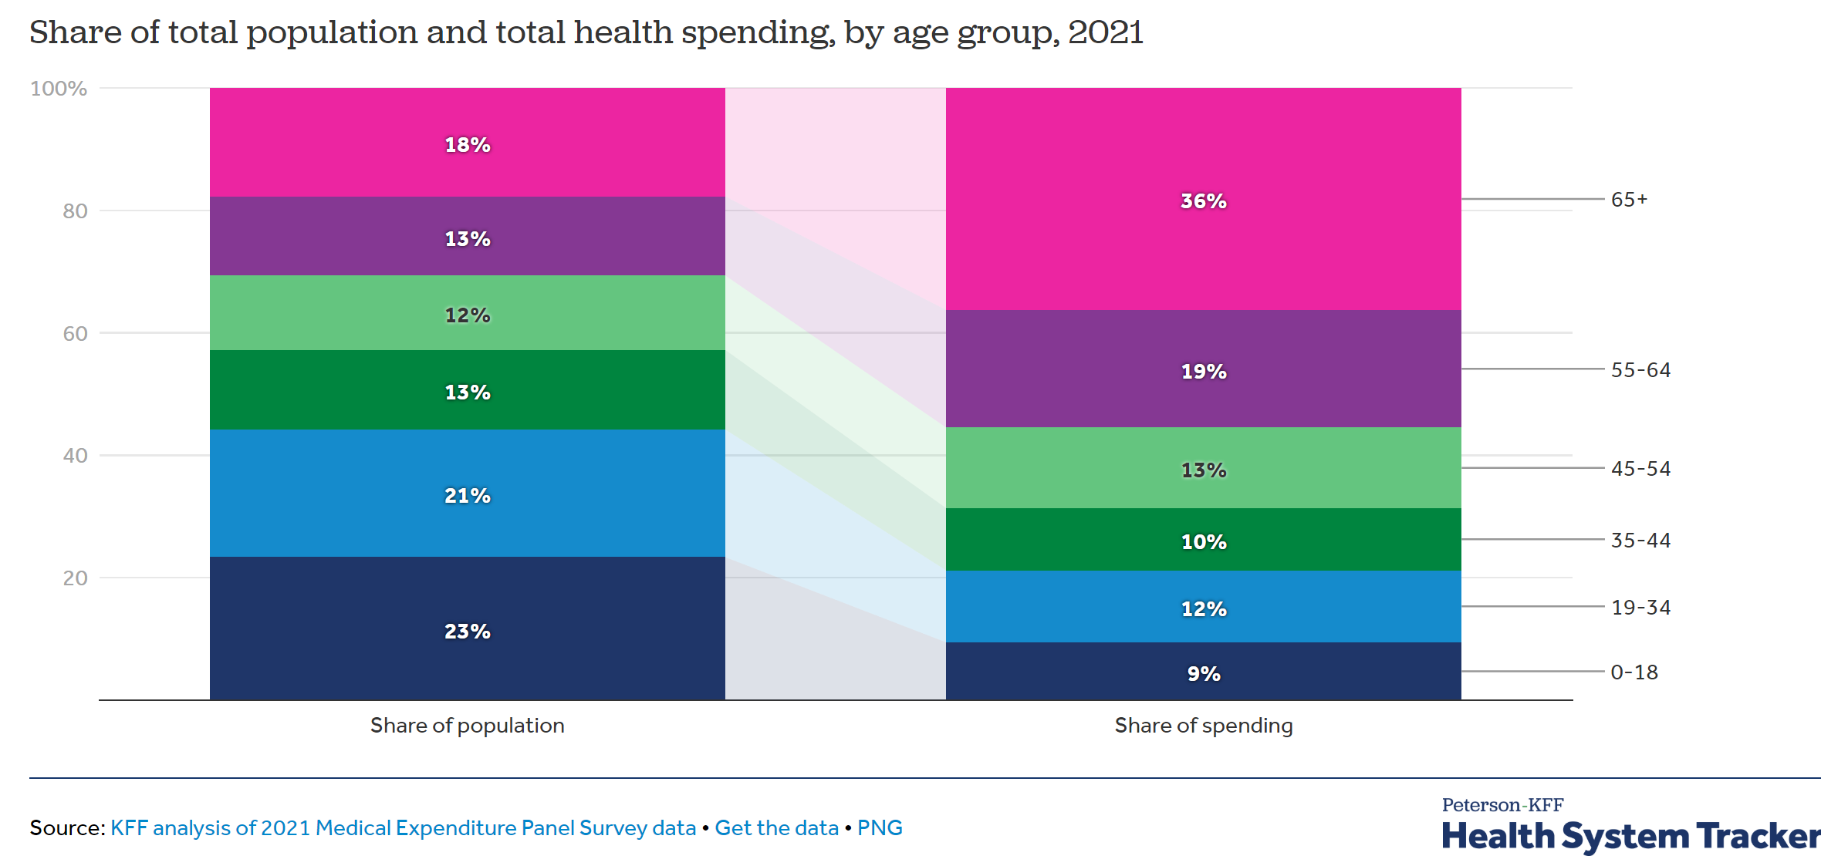
Investment Thesis
US, and world in general, is aging rapidly
Life expectancy increasing (since 2000, up 4 years nominally among developed nations)
To date, 65+ population roughly 17% of US, 10% globally (up 1.5% from just 10 years ago)
The 65+ demographic has grown 64.8% since 2000
65+ population makes up ~40% of healthcare spending, as older population grows, spending will increase with it
Notes:
Sell your investment to the club!
Convince peers to invest
Salesman role (tell a story!)
-Background
-Strengths / weaknesses
-Financial analytics
-Unique success factors AND risks
-Executive leadership group
-Enter / exit strategy

Slide 4
Investment Thesis Cont.
National Health Expenditures rising, will only continue to rise
Rising Specialty Drug Demand: Specialty pharmaceuticals, including biologics and personalized medicine, are a rapidly growing segment of the pharmaceutical market.
Specialty drugs now representing about 75% of the
approximate 7000 new drugs under development
McKesson is largest specialty pharmaceutical distributor
The healthcare industry is experiencing consolidation
McKesson's scale and distribution network provide a
competitive advantage in this environment
Notes:
Sell your investment to the club!
Convince peers to invest
Salesman role (tell a story!)
-Background
-Strengths / weaknesses
-Financial analytics
-Unique success factors AND risks
-Executive leadership group
-Enter / exit strategy

Slide 5
Valuation
Revenue Growth: McKesson reported 18% year-over-year revenue growth in its latest quarter, driven by strong pharmaceutical distribution performance and specialty drug sales.
Profitability: posted an adjusted operating profit growth of 16% and continues to enhance operational efficiency.
Free Cash Flow: While free cash flow was negative $2.2 billion last quarter due to working capital fluctuations, full-year guidance remains strong at $4.8 billion to $5.2 billion.
Valuation: McKesson trades at a trailing P/E ratio of 27.39 and a forward P/E ratio of 16.39, thus future growth implied
EBITDA: stands at $5.16 billion. EBITDA margin is ~2.45%, which is within historical data for pharmaceutical distributors.
Compared to its peers, McKesson has superior revenue growth and margin expansion
Notes:
Sell your investment to the club!
Convince peers to invest
Salesman role (tell a story!)
-Background
-Strengths / weaknesses
-Financial analytics
-Unique success factors AND risks
-Executive leadership group
-Enter / exit strategy

Slide 6
Target + Risks
McKesson’s EV/EBITDA: ~11x
2025 EBITDA Projection: ~$5.5 billion
Enterprise Value (EV) = EBITDA × EV/EBITDA → $5.5B × 11 = $60.5B
equity value per share is ~$670
WACC/Discount Rate: Central estimate of 6.8%
Long Term Growth Rate: 2%
Resulting fair value of $737.61
Current $640, potential upside of 16.2%
Our Target Value = $710
Risks:
Medicare and Medicaid
Revenue tied to these programs, if Trump cuts, could see downturn for MCK
Market Distrust
2024 was rough year for health sector
Investors prioritizing tech
YTD price return was down 21% from S&P
General Policy Uncertainty
Trumps health policy is generally unclear
Severity of regulation on specific pharmaceuticals yet to be seen
Notes:
Sell your investment to the club!
Convince peers to invest
Salesman role (tell a story!)
-Background
-Strengths / weaknesses
-Financial analytics
-Unique success factors AND risks
-Executive leadership group
-Enter / exit strategy

